Slide 1
Detecting Patterns in Criminal Activities Using K-means and DBSCAN Clustering
Edwin N. Garcia
MS Data Science Lewis University

Slide 2
Objectives
Discuss the Problem
Describe the Methods Used and Motivations
Discuss the Results
Limitations and Expectations

Slide 3
Thesis Problem
Use machine learning to detect similar property crimes, such as burglary, theft, and larceny. I will use features such as time of day, day of week, and location in identifying crime patterns

Slide 4
Crime Dataset
Harris County Sheriff’s Office Incident Dataset
July 01 to October 30, 2016
35, 326 rows, 17 features
Used API to overcome 1000 row limit
https://moto.data.socrata.com/dataset/Harris-County-Sheriff-s-Office/p6kq-vsa3/data

Slide 5
Crime Dataset
16, 907 property crimes
Cleaned dataset = 16, 861, 11 features
46 rows (0.27%) removed - Outside jurisdiction
Used iPython to perform data extract and cleaning
Keywords | Theft, Robbery, Stolen, Burglar, Larceny

Slide 6
Fitting Data
Column | Type | Category
Address Block | String | Categorical
Date of Week | String | Categorical
Hour of Day | Integer | Categorical
Incident Date/Time | Date | Continuous
Incident Type Primary | String | Categorical
Latitude | Float | Continuous
Longitude | Float | Continuous
Parent incident | String | Categorical
State(ZIP Code) | Integer | Categorical

Slide 7
Label Encoder
Scikit-learn
from sklearn import preprocessing
add_le = preprocessing.LabelEncoder()
df['address'] = add_le.fit_transform(df['address'])

Slide 8
Scale
Scikit-learn
from sklearn import preprocessing
df['address'] = preprocessing.scale (df['address'])

Slide 9
Data Description
 | address | city | day | hour | incident_datetime | type | latitude | longitude | parent_incident | state
count | 1.69E+04 | 1.69E+04 | 1.69E+04 | 1.69E+04 | 1.69E+04 | 1.69E+04 | 1.69E+04 | 1.69E+04 | 1.69E+04 | 1.69E+04
mean | 3.60E-17 | -1.54E-16 | -8.54E-16 | 2.23E-16 | -1.46E-15 | -9.98E-17 | -3.22E-18 | 1.33E-18 | 6.49E-16 | -7.68E-17
std | 1.00E+00 | 1.00E+00 | 1.00E+00 | 1.00E+00 | 1.00E+00 | 1.00E+00 | 1.00E+00 | 1.00E+00 | 1.00E+00 | 1.00E+00
min | -1.68E+00 | -1.41E+00 | -1.44E+00 | -2.11E+00 | -1.75E+00 | -1.52E+00 | -2.14E+00 | -1.78E+00 | -1.85E+00 | -1.44E+00
25% | -8.72E-01 | -8.16E-01 | -9.53E-01 | -6.85E-01 | -8.65E-01 | -9.97E-01 | -7.98E-01 | -8.56E-01 | -1.61E-03 | -4.54E-01
50% | 1.33E-02 | -1.02E-01 | 1.74E-02 | 1.07E-01 | -7.07E-04 | 4.11E-02 | 5.21E-02 | 4.61E-03 | -1.61E-03 | -1.55E-02
75% | 8.64E-01 | 6.72E-01 | 9.88E-01 | 7.40E-01 | 8.67E-01 | 1.08E+00 | 8.42E-01 | 7.84E-01 | 6.16E-01 | 3.86E-01
max | 1.77E+00 | 1.98E+00 | 1.47E+00 | 1.53E+00 | 1.77E+00 | 1.25E+00 | 1.91E+00 | 2.01E+00 | 1.85E+00 | 8.60E+00

Slide 10
KMeans
Define k value
Elbow
Silhouette
Gap Statistic

Slide 11
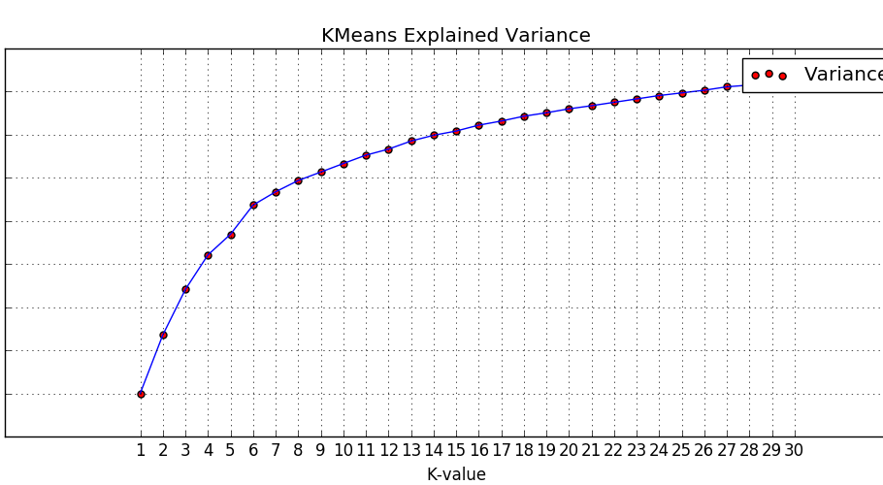
Elbow Method

Slide 12
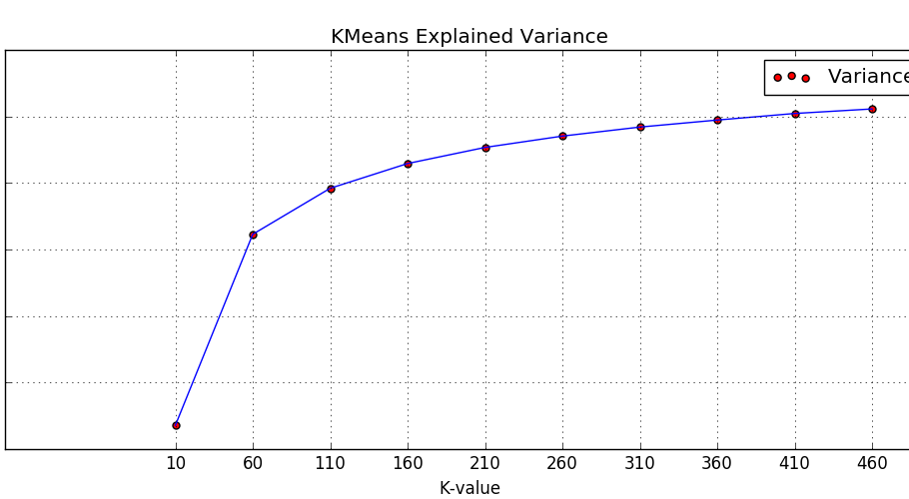
Elbow Method

Slide 13
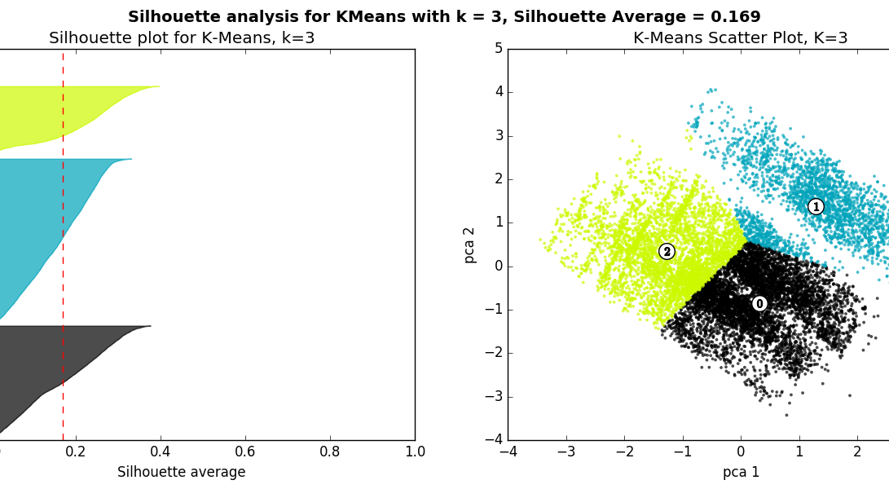
Silhouette Coefficient

Slide 14
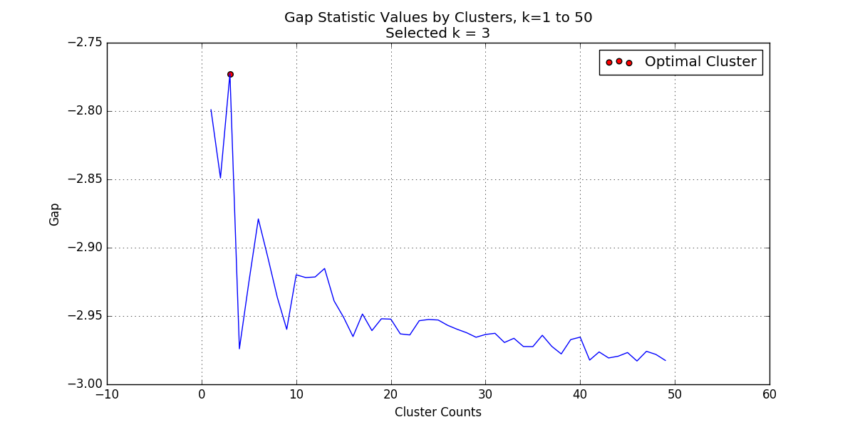
Gap Statistic

Slide 15
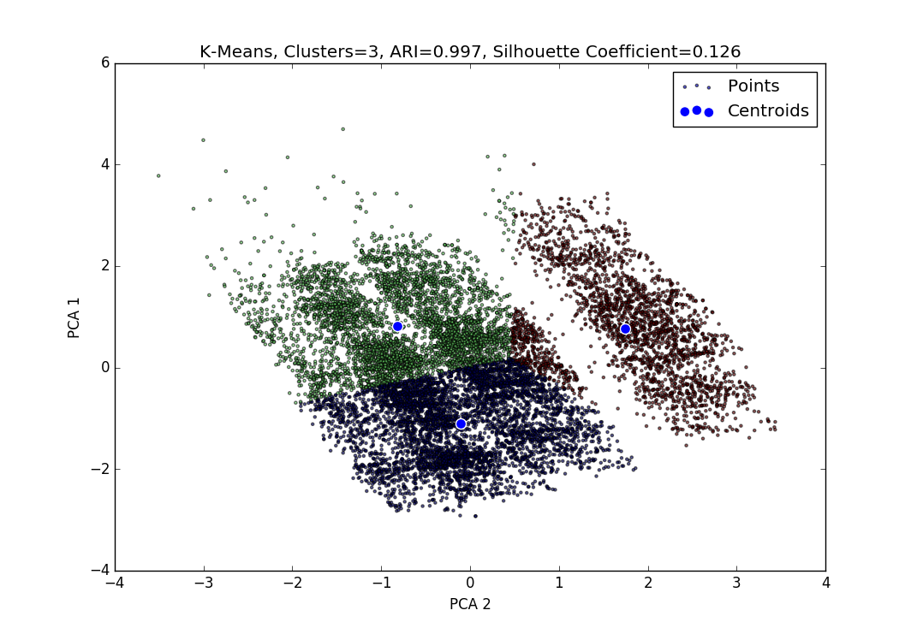
K-Means k = 3

Slide 16
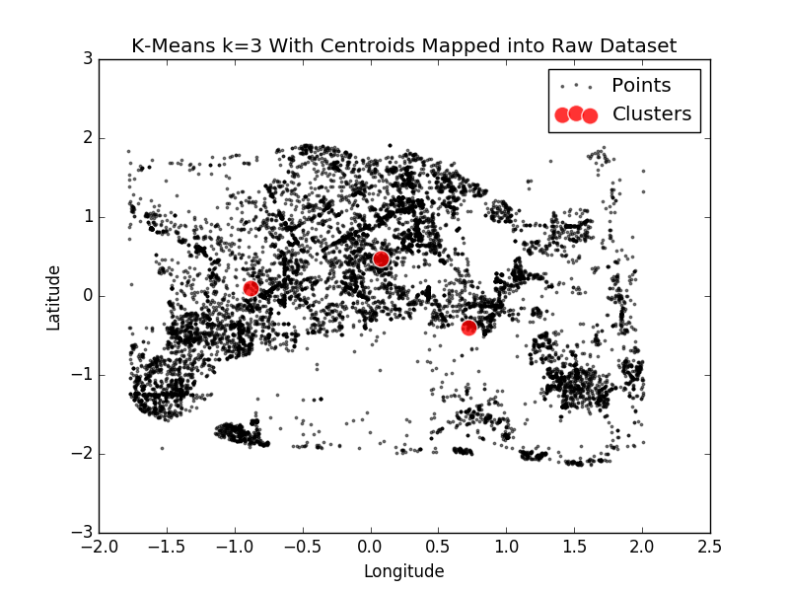
K-Means k = 3

Slide 17
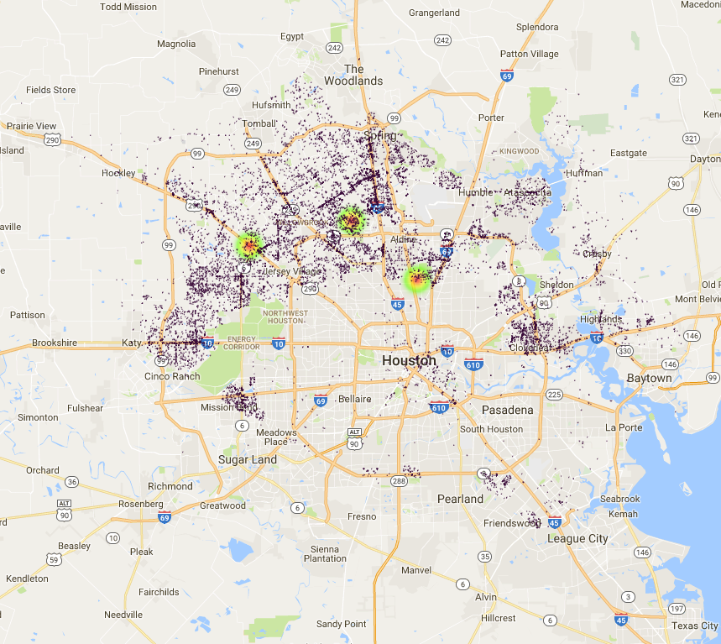
Heatmap Overlay

Slide 18
DBSCAN
Definition
Choosing the epsilon and the minimum points

Slide 19
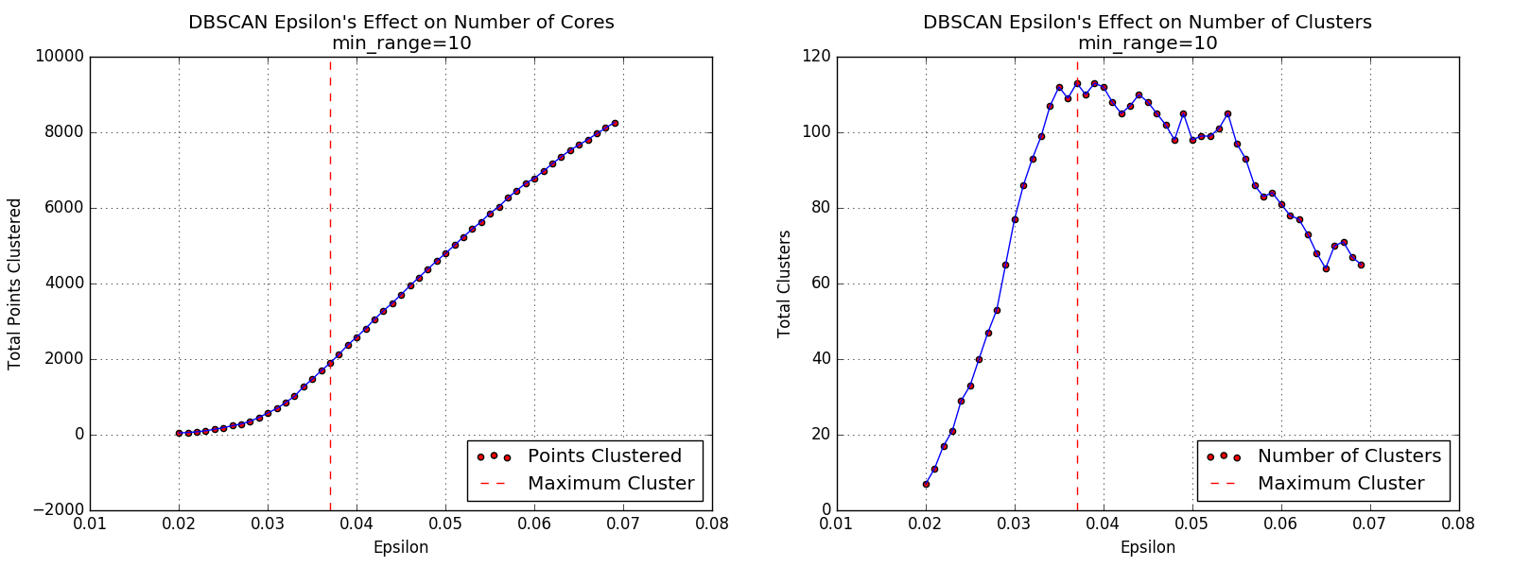
Choosing Epsilon

Slide 20
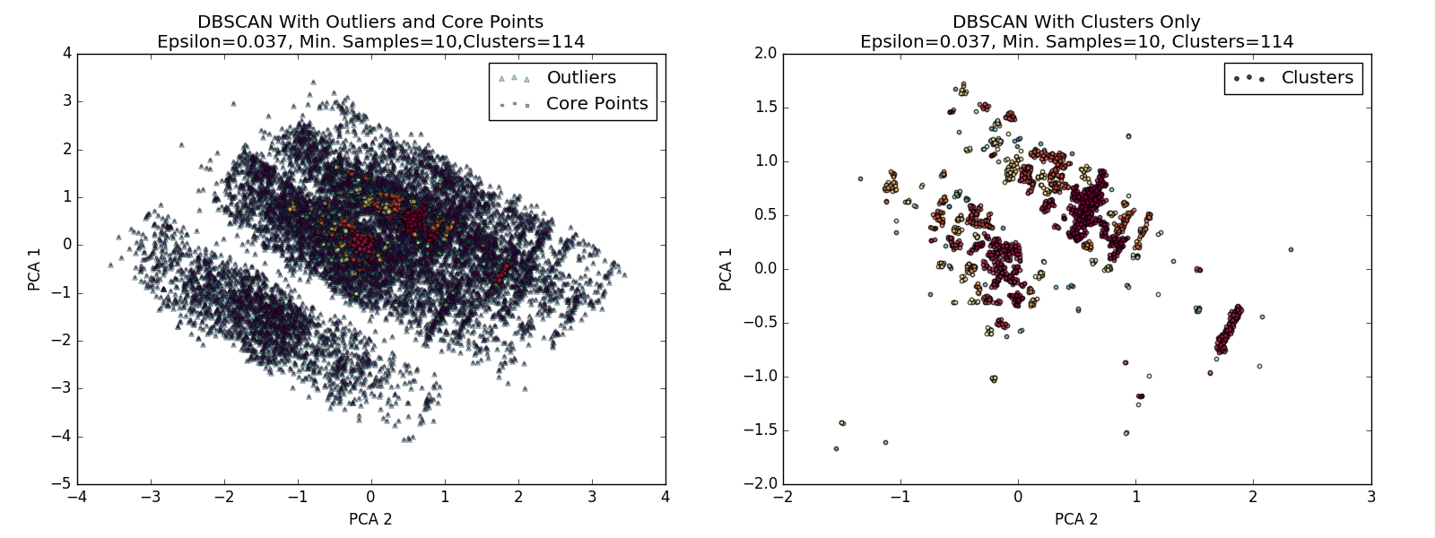
DBSCAN

Slide 21
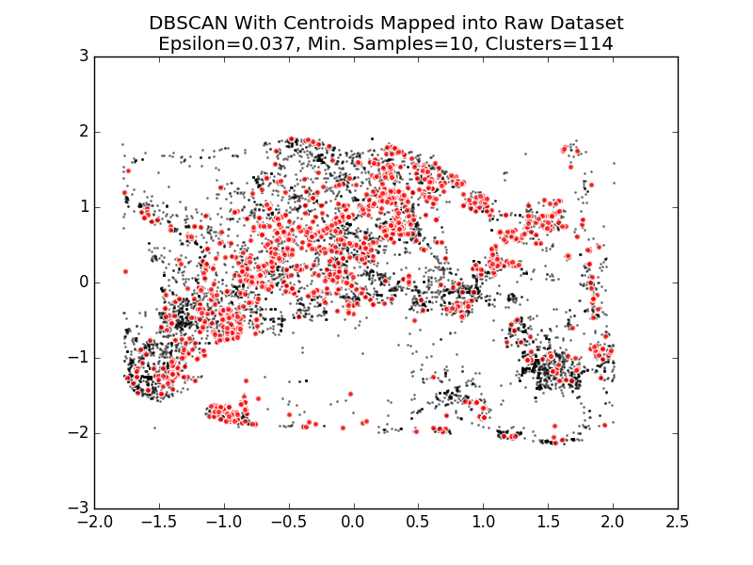
DBSCAN

Slide 22
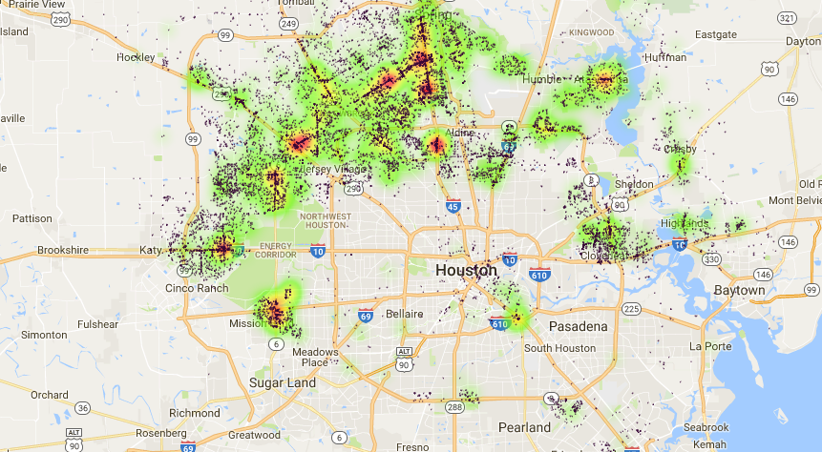
Heatmap Overlay

Slide 23
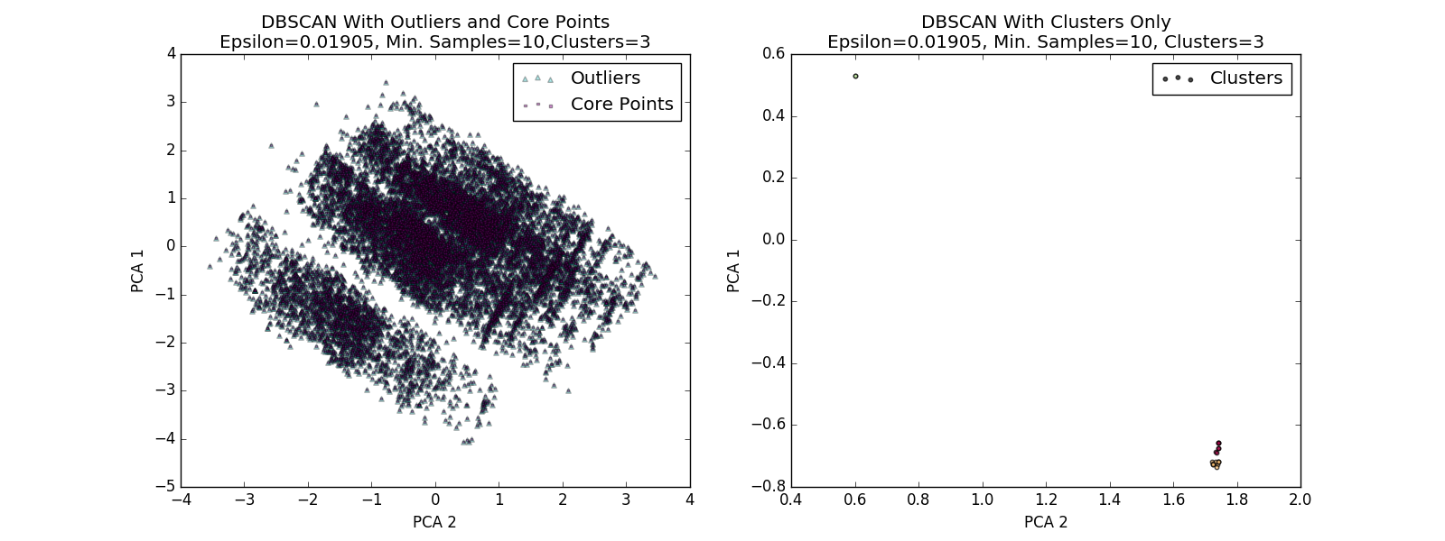
Other Tests
DBSCAN with 3 clusters. Epsilon = 0.01905

Slide 24
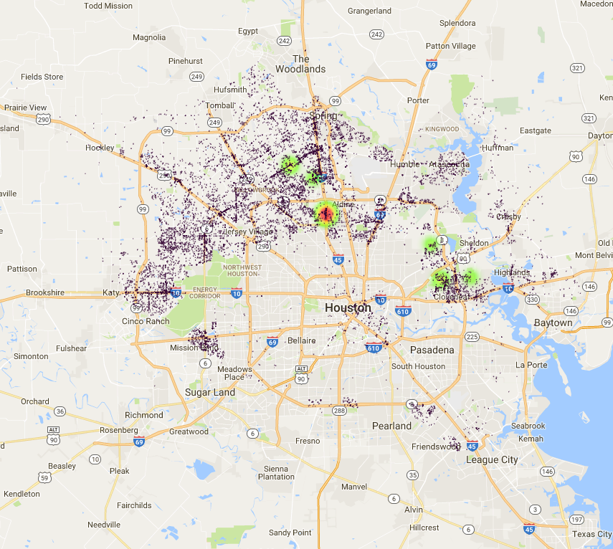
DBSCAN, 3 Clusters

Slide 25
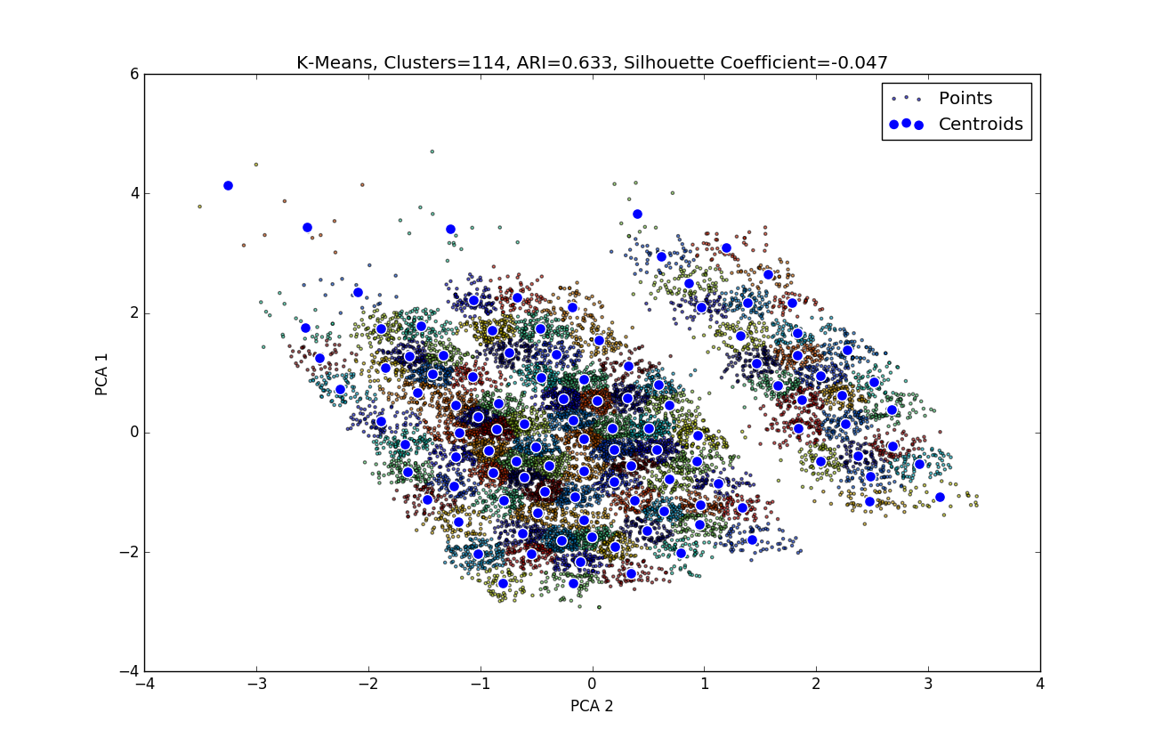
K-Means k = 114

Slide 26
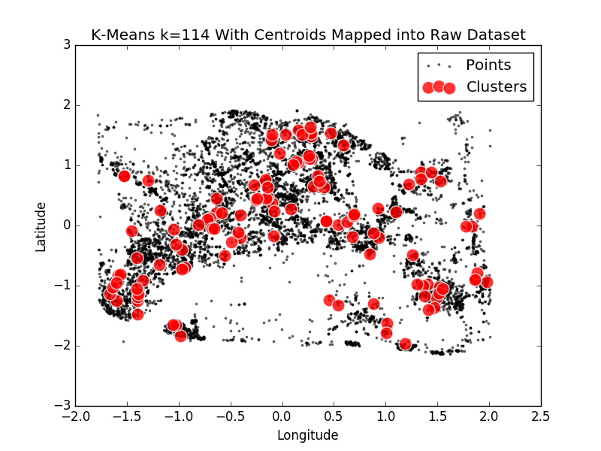
K-Means k = 114

Slide 27
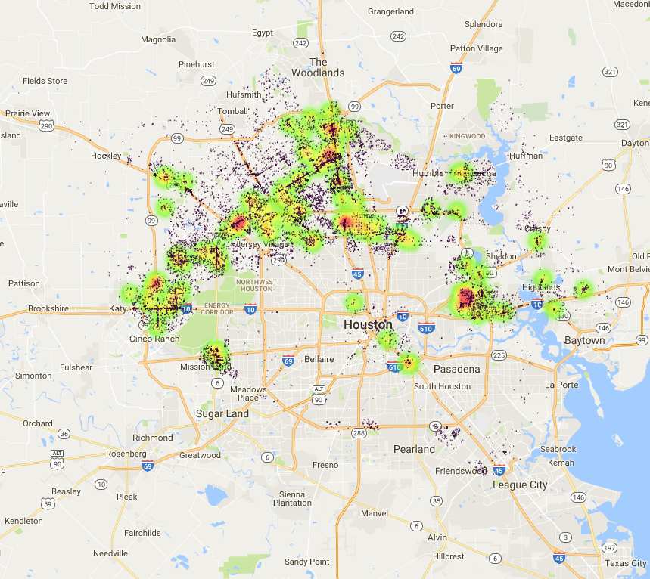
Heatmap Overlay

Slide 28
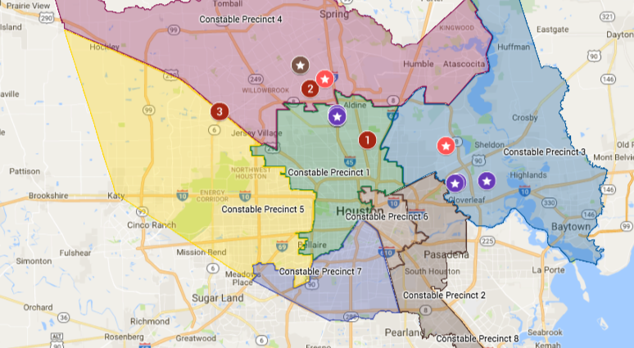
Practical Applications

Slide 29
Lessons
Data cleaning is a challenge.
Computation and documentation becomes complex
Algorithms are not one-step process
Lots of room for growth in clustering and pattern recognition

